Slide 1
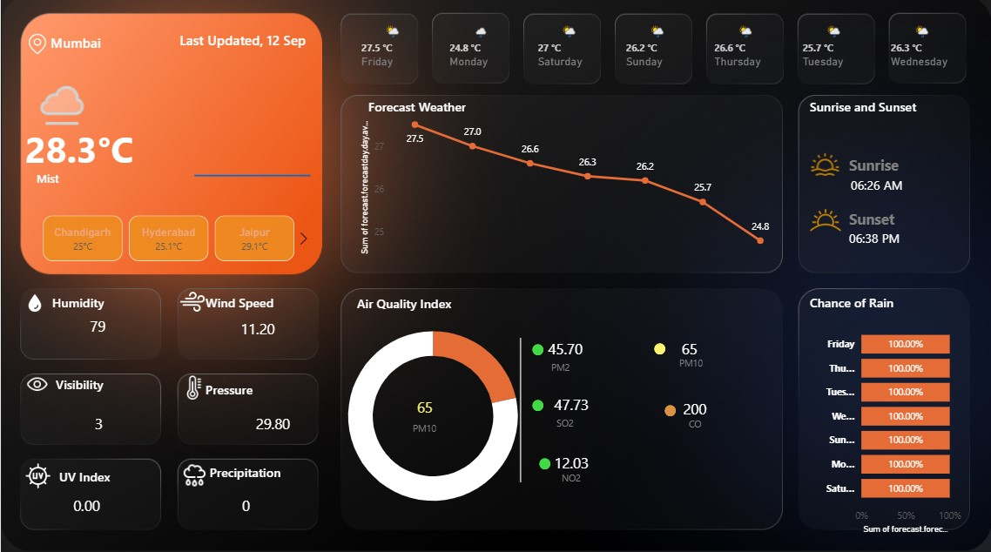
Weather Dashboard
A comprehensive real-time environmental monitoring system designed to provide accurate, accessible weather information for developers and designers building the next generation of weather applications.

Slide 2
Project Overview
Purpose
Target Users
The Weather Dashboard delivers real-time atmospheric data and forecasts for Mumbai, serving as a critical tool for monitoring multiple environmental parameters simultaneously. The system provides comprehensive weather trends and forecasts spanning a full week, enabling users to make informed decisions based on current and predicted conditions.
General public seeking reliable, up-to-date weather information for daily planning
Professionals requiring precise environmental data for operational decisions
Weather enthusiasts and researchers tracking atmospheric patterns and trends
Emergency services monitoring severe weather conditions

Slide 3






Core Dashboard Components
Current Weather
Wind & Humidity
Real-time temperature display (28.3°C) with comprehensive weather condition indicators, providing instant visibility into current atmospheric state
Continuous monitoring of wind speed (11.20 km/h) and humidity levels (79%), essential metrics for comfort and safety assessment
Visibility Index
Air Pressure
Current visibility measurement (3 km) helps users assess conditions for travel and outdoor activities with precision
Atmospheric pressure monitoring (29.80 inHg) tracks barometric changes that indicate incoming weather systems
UV Index
Precipitation
Real-time UV radiation levels (0.00) provide crucial information for sun exposure safety and outdoor planning
Accurate rainfall measurement (0 mm) tracks current precipitation and accumulation over time

Slide 4





7-Day Weather Forecast
The dashboard features an intuitive temperature trend visualization spanning the entire week, displaying fluctuations from 27.5°C to 26.3°C. This graphical representation enables users to quickly identify weather patterns and plan accordingly for the week ahead.
Friday
Saturday
Sunday
27.5°C - Warmest day of the week
27.0°C - Continued warm conditions
26.2°C - Slight temperature drop
Monday
Tuesday
Wednesday
24.8°C - Coolest day predicted
25.7°C - Temperature recovery begins
26.3°C - Warming trend continues
Thursday
26.8°C - Week-end stabilization

Slide 5
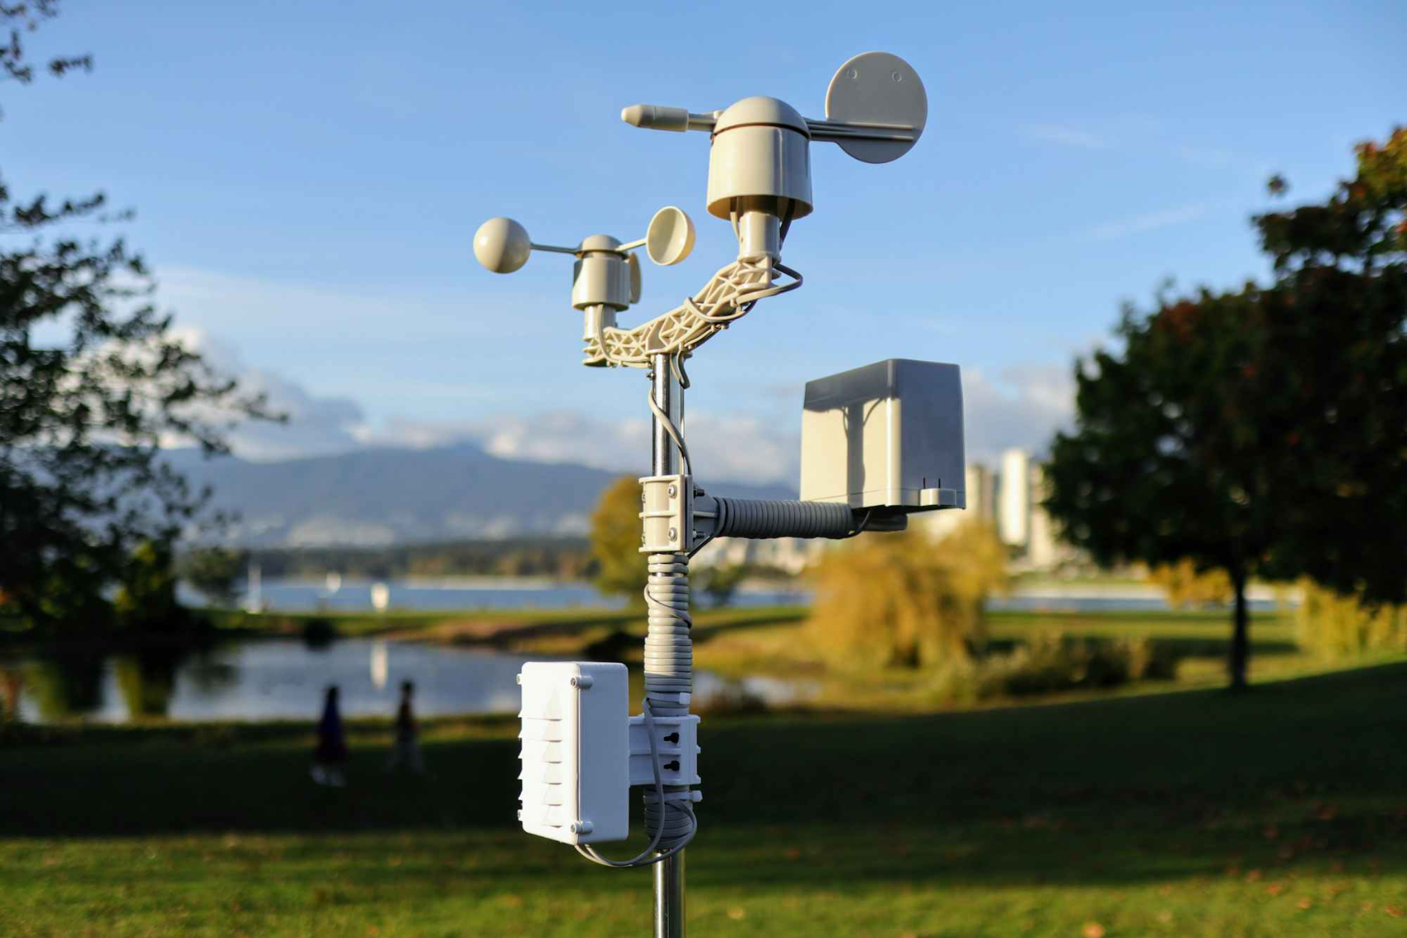

Advanced Monitoring Capabilities
Air Quality Index
Sunrise & Sunset
PM10 Level: 65
Sunrise: 06:26 AM
The dashboard monitors critical air quality parameters including PM2.5 particulate matter, sulfur dioxide (SO2), carbon monoxide (CO), and nitrogen dioxide (NO2) levels. This comprehensive tracking ensures users stay informed about air quality conditions that may affect health and outdoor activities.
Sunset: 06:38 PM
Astronomical data provides precise timing for sunrise and sunset, enabling better planning for photography, outdoor events, and understanding daylight duration. This information integrates seamlessly with other weather metrics for complete environmental awareness.

Slide 6
Rain Forecast Analysis
The precipitation probability tracker displays a comprehensive 7-day rain forecast, with all days currently showing 100% chance of rain. This critical information helps users prepare for sustained wet weather conditions and plan activities accordingly.
100%
100%
100%
Friday
Saturday
Sunday
Expect continuous rainfall throughout the day
Rainfall continues with no breaks expected
Persistent precipitation maintains through weekend
100%
100%
100%
Monday
Tuesday
Wednesday
Week begins with sustained rainfall conditions
Continued wet weather pattern persists
Mid-week rainfall shows no signs of clearing
100%
Thursday
Week concludes with ongoing precipitation

Slide 7
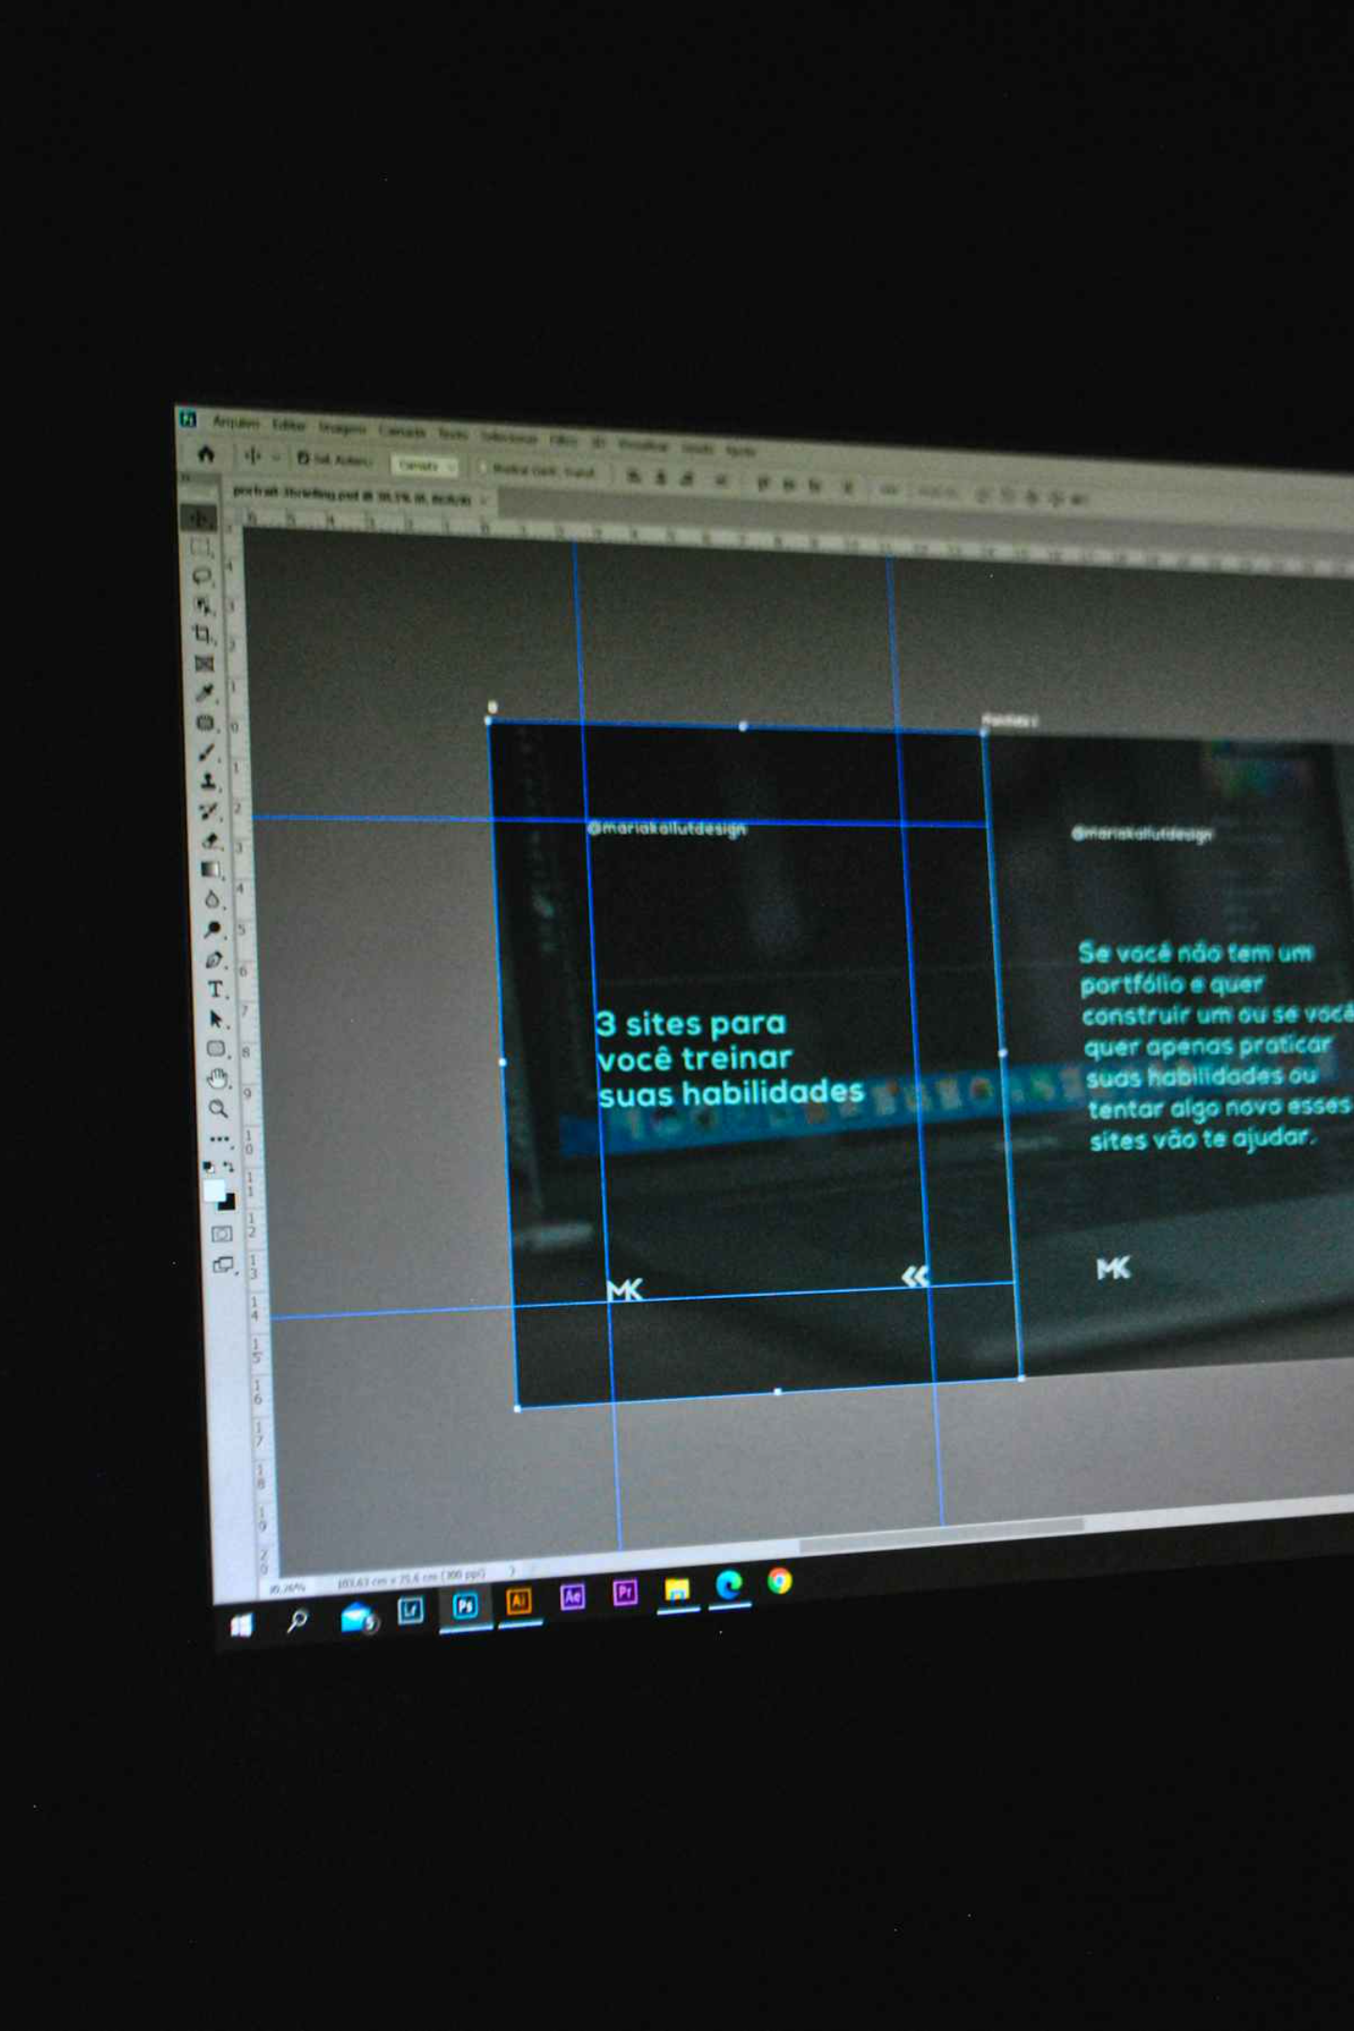
Design Philosophy
Visual Design Principles
Dark theme optimized for reduced eye strain during extended viewing sessions
Strategic orange accent colors (#16FFBB, #29DDDA) for emphasis and visual hierarchy
Card-based layout providing clear content organization and separation
Gradient backgrounds creating depth and visual interest without distraction
User Experience Focus
Intuitive information hierarchy prioritizing most critical weather data
Clear data visualization with interactive graphs and charts
Multi-city selection capability for tracking multiple locations
Fully responsive grid layout adapting seamlessly across devices

Slide 8
Technical Implementation
Technology Stack
The dashboard leverages modern web technologies to deliver a robust, scalable solution. Built with React.js for component-based architecture, the system integrates weather APIs for real-time data while maintaining cross-browser compatibility and responsive design principles.
Frontend Technologies
Data Visualization
HTML5, CSS3, JavaScript, React.js for building dynamic, interactive user interfaces
Chart.js and custom components for rendering weather graphs and metrics
API Integration
Design System
REST API architecture connecting to weather services and air quality monitoring feeds
Responsive design framework ensuring optimal viewing across all device sizes
Data Sources
Key Technical Features
Real-time weather API integration for current conditions
Auto-refresh mechanism for live data updates every 5 minutes
Air quality monitoring services providing pollutant data
Multi-city support with persistent user preferences
Astronomical data feeds for sunrise and sunset times
Interactive data visualization with zoom and filter capabilities
7-day forecast data streams for predictive information
Comprehensive cross-browser compatibility testing

Slide 9





Future Enhancements & Roadmap
Phase 1: Enhanced Localization
Implement GPS-based user location detection for automatic local weather display, custom location favorites management, and weather alerts tailored to user's current position
Phase 2: Alert System
Deploy comprehensive weather alerts and push notifications for severe conditions, configurable thresholds, and historical weather data analysis for pattern recognition
Phase 3: Mobile Platform
Launch dedicated mobile applications for iOS and Android with offline capability, widget customization options, and seamless synchronization across devices
Phase 4: Global Expansion
Integrate weather radar map visualization, multi-language support for international users, dark/light theme toggle, and enhanced data export features for power users

Slide 10
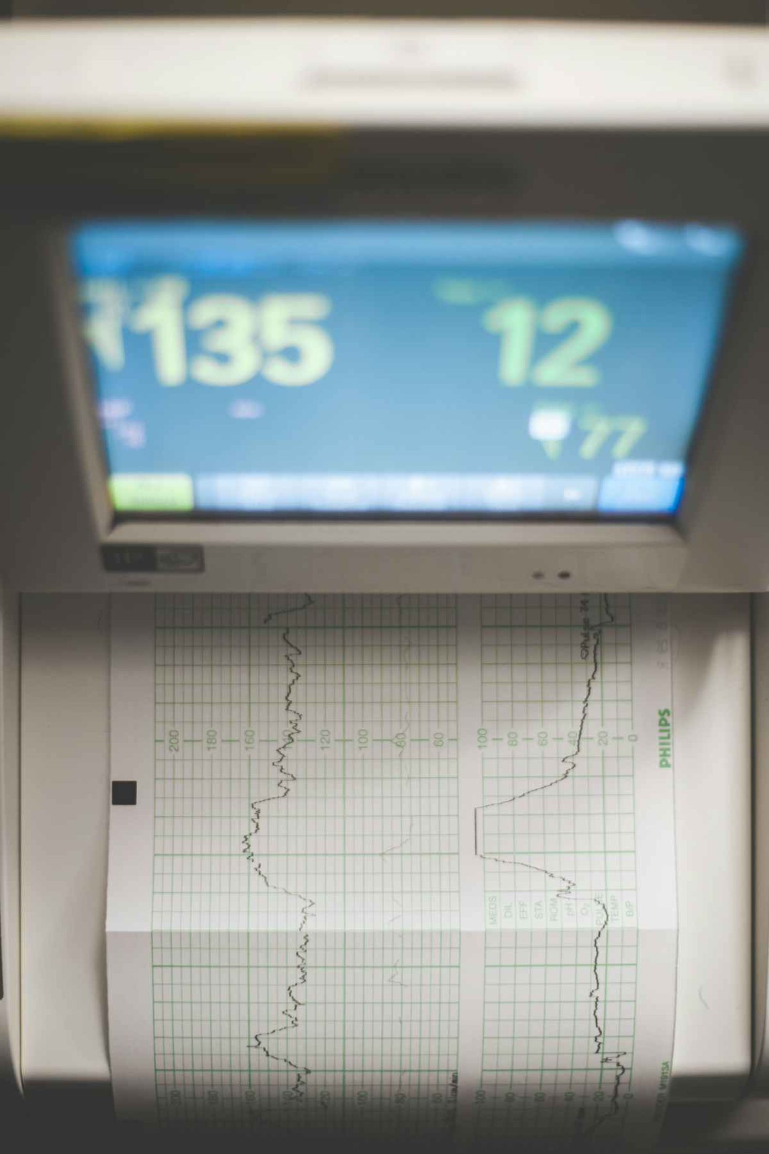

Thank You
Questions & Discussion
The Weather Dashboard represents a comprehensive solution for real-time environmental monitoring, combining accurate data delivery with intuitive design principles. We're excited to continue evolving this platform to meet the needs of developers, designers, and end users seeking reliable weather information.
Ready to integrate? Feel free to ask questions about implementation details, API integration, design specifications, or technical architecture. Let's discuss how this dashboard can serve your specific use case.

